Slide 1
See3PO
Frank Marino, Nick Wang, Jacky Yu, Hao Wu and Debarati Basu
Department of Computer Science
University of Massachusetts at Boston
Tyler Garaas and Srikumar Ramalingam
Mitsubishi Electric Research Laboratories (MERL)

Slide 2
Why this project?
Need to add content here

Slide 3
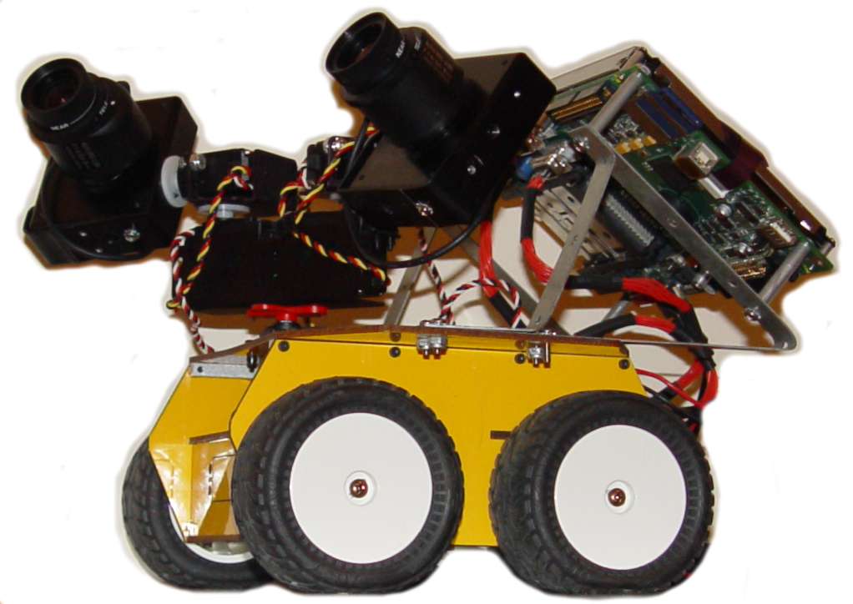
The Anatomy of a See3PO
Cameras
Used by the Locator to get position
Local Brain
(currently being replaced)
Runs the local version of our program.
Communicates with the Host PC and with the Atom.
Atom Computer
Controls the Servos and the Wheels

Slide 4
Introduction of our robot
Need to add the slide Hao Used

Slide 5
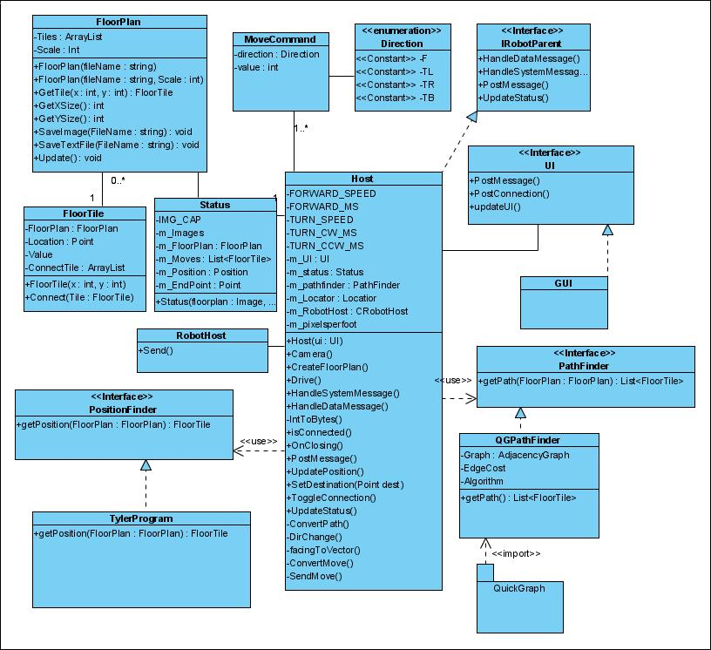
Class Diagram
Notes:
Before the Host part, first introduce the user interface

Slide 6
Host
Floor Plan Processing
PathFinder
Path
Floor Plan
Position
Destination
FP Image
Floor Plan
Local Brain
Robot Images
Host
GUI
Commands
FP Image
Destination
Floor Plan
Robot Images
Position
Locator
Robot
Host PC

Slide 7
Host – An overview
The Host class manages all other Host-Side processes
The User selects a Floor Plan Image from the GUI
Host sends this image to FloorPlanProcessing, which returns a FloorPlan.
This FloorPlan is sent to PathFinder to be converted into a graph. It is also sent back to GUI for display.

Slide 8
Host – An overview
Either the User (GUI) or the Locator sets the robot’s current Position, then the User (GUI) selects a Destination.
If using the Locator, the Host requests images from LocalBrain, and sends these to the Locator.
These points are sent to the PathFinder, which returns a Path of (X,Y) coordinates.
Host converts this Path to distinct Left/Right/Duration MoveComand objects, and sends them to the LocalBrain, one at a time.

Slide 9
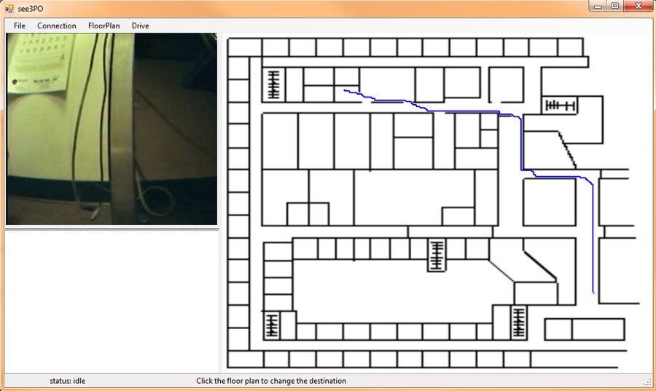
GUI

Slide 10
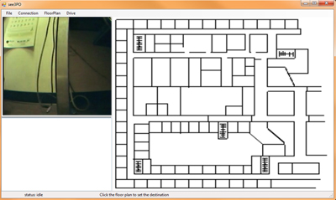
GUI
Status Screen
Displays detailed messages from the Host
Live Panel
Displays a live view from the Robot
Floor Panel
The Main Interface:
Displays The Floor Plan
Allows the user to set:
Scale
Current Position
Destination
Displays the best Path
During execution, updates the Path and Position.
Connection Status
Instructions

Slide 11
Locator
Returns the current Position of the robot: Location(X,Y)
Facing (0 -359)
This position is used by PathFinder to create a Path, and to monitor and correct the robot’s progress while moving.
The only external inputs required are:
A Floor Plan Image
Robot Images from the robot’s two cameras
contd..
Notes:
Tyler and Shi will be providing us with a location program, which we have been calling “WHERE AM I”
WhereAmIwill be used to continuously update See3PO on its current position, including both Location and Orientation
The only external data required by WhereAmI will be a stream of images transmitted from the Robot

Slide 12
Locator
Advantages:
Precise
Works Indoors
Self-correcting
Recognizes changes
open/closed door
obstacles
Notes:
Because of this, See3PO will be capable of working in situations where a GPS-based system would not, Indoors, for example
Additionally, this system will be more precise than GPS, which is accurate only to about 20 meters.
Because of the way that WhereAmI will work, it will be simple to compare expected views to Observed views
This will allow recognition of changes such as opened or closed doors or obstacles

